Slide 1
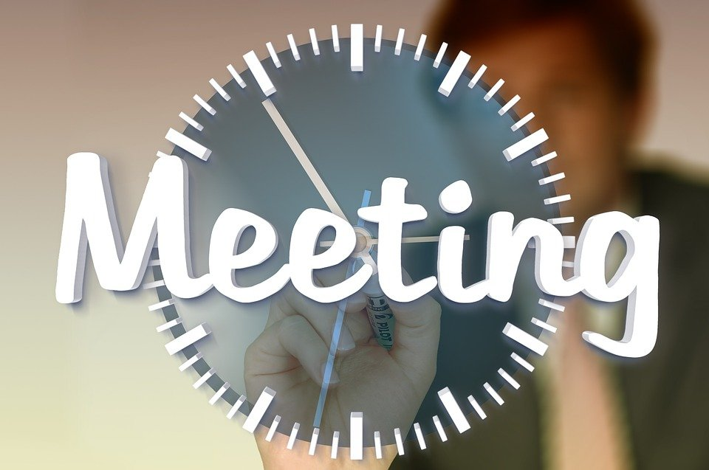
BJEL2013 ENGLISH FOR CAREER PREPARATION

Slide 2
Let’s Chat
Do people generally like meetings? Why or why not?
Have you ever attended a meeting? How did you feel?
What was the most effective meeting you have ever attended? Why?
What was your worst meeting? Why?

Slide 3

Define Meeting
Gathering of two or more people with a common interest to exchange ideas for a specific purpose.

Slide 4
Why are Meetings Needed?
To solve problems or conflicts
To brainstorm or generate ideas
To give and obtain information
To make announcements
To plan activities
To make decisions on the spot
To delegate tasks and jobs
To report on progress

Slide 5
Types & Functions of Meetings
Type of Meeting | Function
Annual General Meeting | To appoint new committee members, report past year’s achievements and plan activities/events for the coming year.
Extraordinary General Meeting | To deliberate on urgent matters that need all involvement.
Informational Meeting | To inform members on the latest dev or work-related matters.
Decision-Making Meeting | To make important decisions that may affect the business or the co. and get the approval of all relevant members.
Problem-Solving Meeting | To solicit possible solutions or recommendations for a problem and decide on the most appropriate way to solve it.

Slide 6

Common Problems with Meetings
Unnecessary meetings
Waste of time
Do not follow agenda
Punctuality
Resources
Conflict
Why and how are the items listed a problem in meetings?

Slide 7
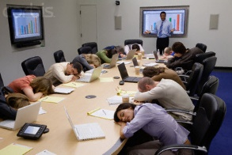
Ineffective Meetings
Poor and ineffective chairperson
Biased chairperson
Passive members
Inattentive members
Unprepared members
Latecomers
Frequent disruptions
Members dominating the meeting
Missing meeting documents
Unclear meeting objectives or purposes
A lot of unnecessary or irrelevant digressions
Meeting outcomes are not achieved

Slide 8
Imagine No More Meetings
How much time would you have?
How productive would you be? Seriously, are you going to be more productive?
What do you lose to meetings, especially to bad meetings?
What do you gain from the best meetings?

Slide 9
Planning a Meeting
Why are we meeting?
Who should attend the meeting?
When should we meet?
Where should we meet?
What materials do we need?

Slide 10
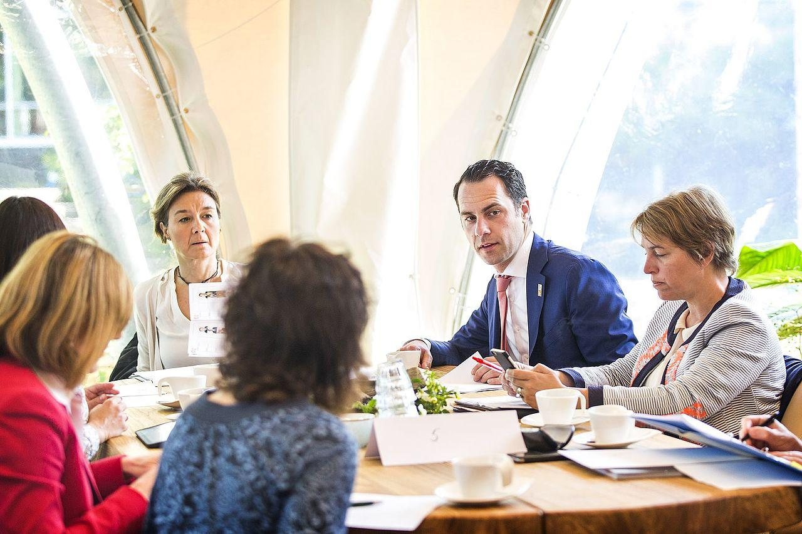
Effective Meetings
Establish the need or purpose
Determine date, time, venue
Circulate a meeting notice
Develop an agenda
Before
Arrive earlier
Conduct the meeting in an orderly manner
Participate actively and constructively
During
Record the meeting minutes
After

Slide 11
Meeting Terminologies
How much time would you have?
How productive would you be? Seriously, are you going to be more productive?
What do you lose to meetings, especially to bad meetings?
What do you gain from the best meetings?

Slide 12

Meeting Terminologies
Term | Meaning
Consensus | A collective or general agreement from the majority of the members
Ballot | A system in decision making; voting secretly and in writing on a particular issue
Quorum | The minimum number of members required to be present at the meeting before it can be convened
Motion | Any proposal submitted for discussion and subsequent decision by voting
Adjournment | Postponing the meeting because of lack of time or as further discussion needs to happen later
Resolution | A formal decision agreed upon at a meeting
Amendment | A proposal to alter motion by adding or deleting words
Casting vote | A vote allowed to the chairperson when there is a tie
Constitution | A document outlining the rules and regulations for the conduct of the business of an organisation

Slide 13
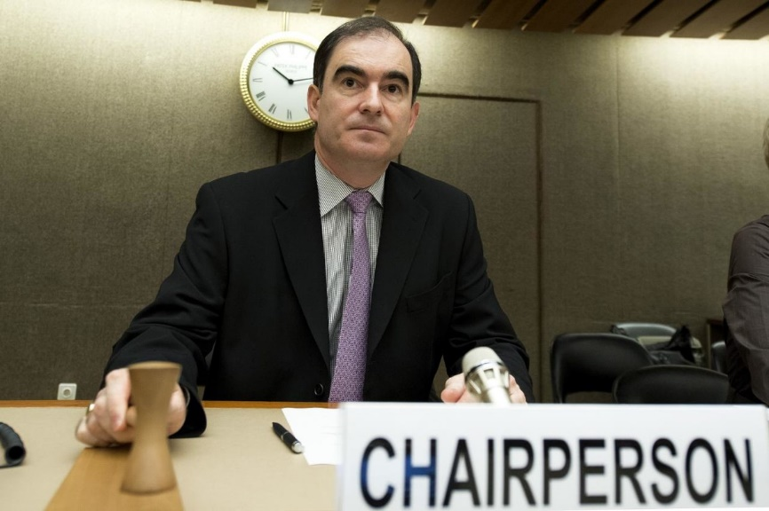
Meeting Participants
CHAIRPERSON
The role of the Chair is to ensure all participants in a meeting can contribute to a structured discussion which leads to a clear decision at the end of the meeting
State objectives/agenda clearly
Follow agenda closely
Call meeting to order
Encourage participation
Summarise discussion
Delegate duties/ responsibilities
Make good decision
Adjourn the meeting (on time)
Clarify misunderstanding

Slide 14

Meeting Participants
SECRETARY
To present an accurate and concise written snapshot of a meeting
To identify and capture key points
To determine the appropriate language
To keep a record of minutes for future reference
Prepare necessary documents
Prepare venue
Send out notice of meeting
Distribute minutes of last meeting
Arrive early, distribute documents
Record the minutes of meeting
Keep relevant documents

Slide 15
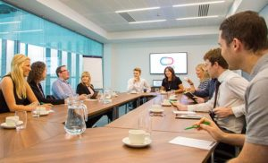
Meeting Participants
Members
Prepare matters that need to be reported
Read minutes of previous meetings
Prepare points
Prepare notes
Participate actively
Listen, support & contribute

Slide 16
At the Start of the Meeting
Welcoming everyone and Introductions
Ensure people know what the meeting is about (Agenda)
Meeting rules
Don’t interrupt other people
Stick to the item on the agenda
Don’t talk amongst yourselves
Respect other people’s views
Keep contributions short and to the point
Start and finish the meeting on time

Slide 17
At the End of the Meeting
Summarise decisions taken and action points to be followed up e.g. who's responsible, by when.
Agree a date for the next meeting - it is usually best to set dates for the year's meetings well in advance.
Agree what special items will be put on the agenda of the next meeting
Ensure that the minutes are written up , checked by the Chair and sent out in good time.

Slide 18
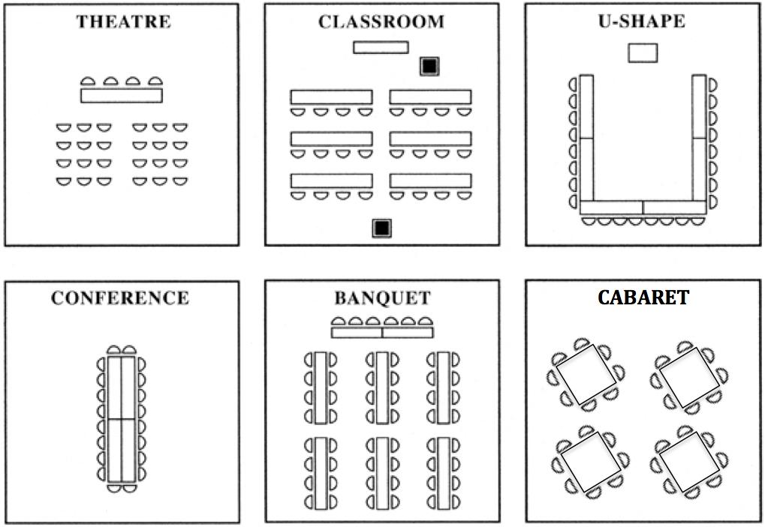
Seating Arrangement
Small group:
Cabaret – problem-solving, generating ideas
Large group:
Theatre, C/room – one-way interaction – sharing info
Large group:
U-shape, Conference – two-way interaction -

Slide 19

Checklist
Did the chairperson:
state the purpose of the discussion?
guide the discussion to the point?
enable effective presentation of proposals or motions, discussion and resolution?
use problem-solving or decision-making strategies?
summarise the discussion?
Did the members:
follow structured discussion procedures?
contribute significantly towards the completion of the issues?
speak logically, clearly and concisely?
use appropriate turn-taking?
complete task roles?

Slide 20
THANK YOU

